Slide 2
RAPID ALERT SYSTEM for FOOD and FEED
An overview of the functioning of the RASFF system as a tool for managing food safety risks in the EU

Slide 3
Contents
Origins, evolution and purpose
Legal Framework
RASFF as a network
Types of notifications
Statistics and trends
RASFF SOPs
Access to RASFF information

Slide 4

Origins, evolution and purpose (1)
“In the beginning, the system was really small. There were only one or two people from the Member States and three from the Commission; we were an efficient team.”
Olga Demine, previous member of the RASFF team, European Commission (1979–1996)
1979 – Members: BE, DE, DK, FR, IE, IT, LU, NL, UK
First case – oranges from Israel

Slide 5
Origins, evolution and purpose (2)
Network of public authorities to ensure swift exchange of information on risks and enforcement measures between its members
NOT a tool for risk communication
Different from administrative assistance under Reg. (EC) 882/2004
Covers direct/indirect risks to human health caused by food/feed and serious risk for animal health/environment deriving from feed

Slide 6
Origins, evolution and purpose (3)

Slide 7
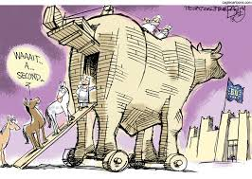
Origins, evolution and purposes (4)
RASFF used in the horsemeat scandal (2013)
Ensured traceability of beef products contaminated with horsemeat across the EU
Horsemeat scandal: no risk but fraud…
A similar but separate IT tool under construction for cross-border cases of food frauds

Slide 8

Legal Framework
Legal basis: Artt.50, 51 and 52 Regulation (EC) 178/2002 (‘General Food Law’)
Implementing measures: Regulation (EU) 16/2011
Guidance texts: RASFF SOPs
N.B. Sectoral EU legislation widened RASFF scope e.g. feed (Art. 29 Reg. (EC) 183/2005)

Slide 9

RASFF as a network (1)
RASFF members (Art.50 (2) GFL):
European Commission, All 28 MS, EFSA
EFTA/EEA countries and EFTA Surveillance Authority
Switzerland (partial member)
Openness – Candidate/third countries and international organisations may join if bilateral agreements with EU so provide (Art. 50 (6) GFL)

Slide 10

RASFF as a network (2)
Network Manager EU Commission (DG SANTE)
All RASFF members must:
designate a single Contact Point (e.g. ECCP, NCPs) and ensure effective communication
operate 24h a day/7 days a week (Art 2 Reg. 16/2011)
Full list of RASFF Contact Points available at
http://ec.europa.eu/food/safety/rasff/members/index_en.htm#1

Slide 11
RASFF as a network (3)
Information flow

Slide 12



Types of notifications (1)
Reg. (EU) 16/2011 (recital 5)- Rules for use of RASFF a) in cases involving a serious risk as per Art. 50(2) GFL and b) other cases which, although pointing to a risk of lesser gravity/urgency. require efficient information exchange
3 main types of notifications

Slide 13

Types of notifications (2)
Rationale: notifications concerning a risk that requires or might require rapid action in another member country (Art. 1 (1) pt. 4 Reg. 16/2011)
Alerts must be sent to ECCP without undue delay and in any event within 48h from when they became aware of the risk (Art. 3 (1))
Following verification, ECCP dispatches to other RASFF members within 24h from reception (Art. 3 (3))

Slide 14
Types of notifications (3)
Rationale: notifications of a risk that does not require rapid action in another member country (Art. 1 (1) pt. 5 Reg. 16/2011)
They may be ‘for follow up’ or simply ‘for attention’, depending on whether or not the product is on the market
They must be notified to the ECCP without delay (Art. 4 (1))
Following verification, ECCP to dispatch to other RASFF members without delay

Slide 15
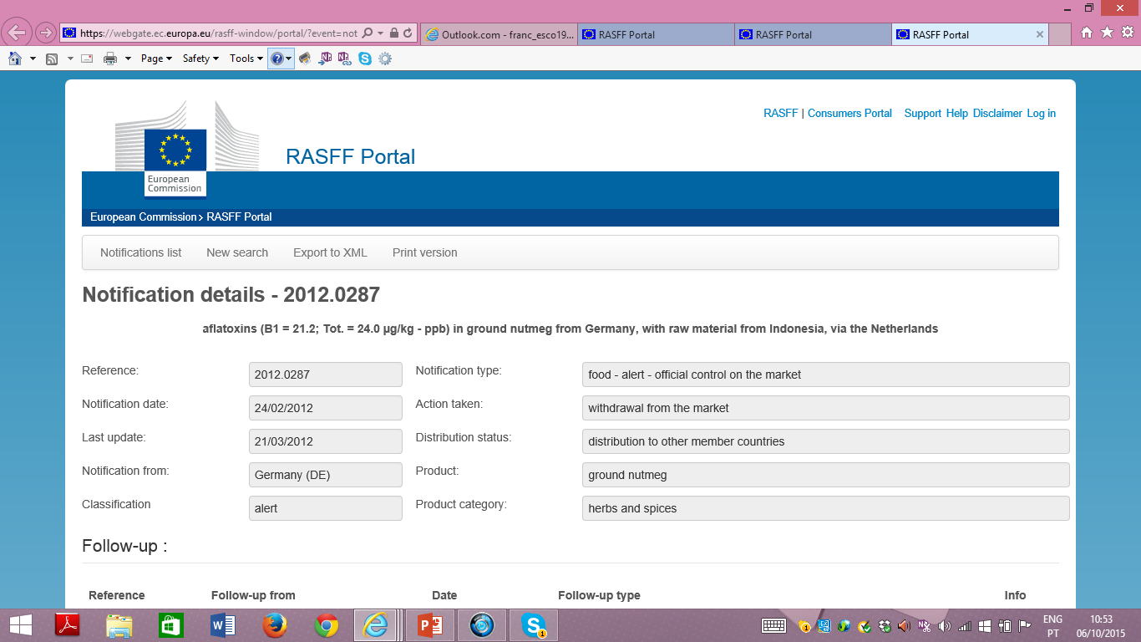
Types of notifications (4)

Slide 16
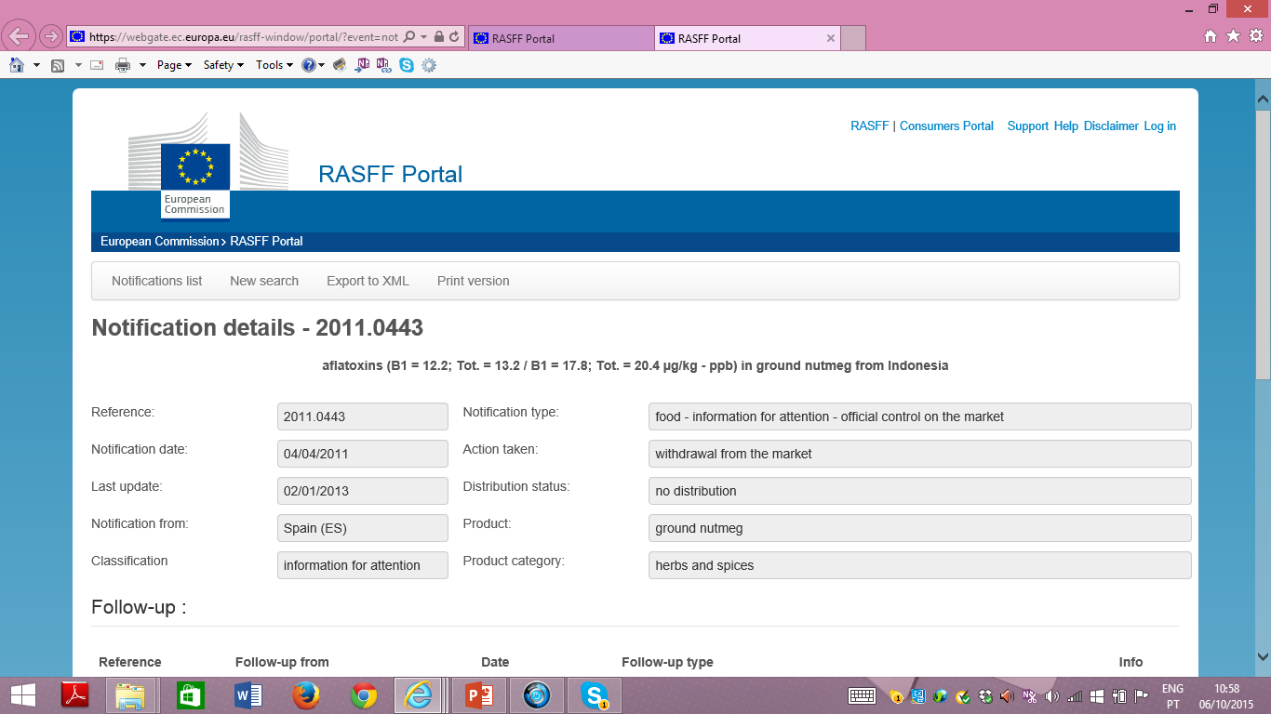
Types of notifications (5)

Slide 17
Types of notifications (6)
Rationale: notifications concerning rejection of cargo, container or a batch of feed/food by competent authority of a border post in the EU (Art. 50 (3), c) GFL + Art. 1 (1) pt. 6 Reg. 16/2011)
They must be sent to ECCP without undue delay (Art. 5 (1))
ECCP to circulate to BIPs and DPEs as appropriate

Slide 18
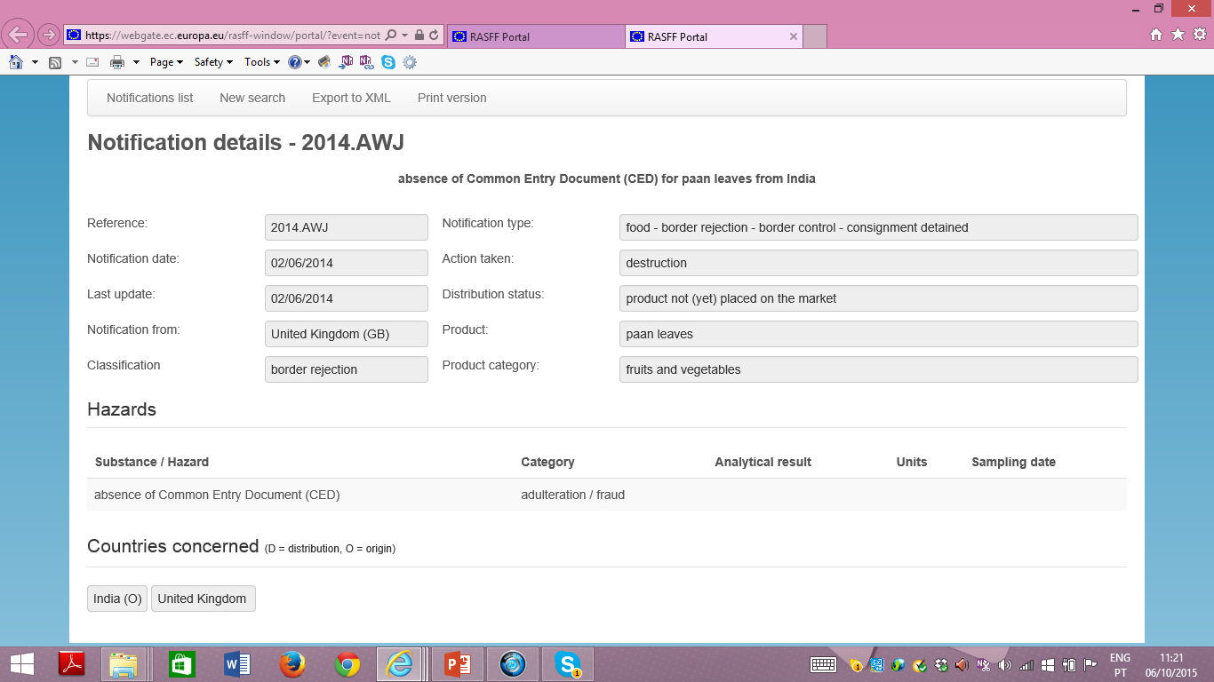
Types of notifications (7)

Slide 19

Types of notification (8)
RASFF News: residual category
Rationale: to communicate any other information that, although not classifiable as an alert or an information notification, may be of interest for enforcement authorities in other MS
‘Original’ vs. ‘follow up’ notification (Art. 1 (1) pt. 7 and 8)

Slide 20

Statistics and trends (1)
Source: RASFF Annual Report 2014
Evolution of notifications per type

Slide 21
Statistics and trends (2)
RASFF evolution per notification basis

Slide 22
Statistics and trends (4)
Most recurrent notifications in 2014

Slide 23
Statistics and trends (5)
Feed: RASFF evolution 2012-2014

Slide 24
RASFF SOPs (1)
No legal value – only guidance
10 SOPs covering various areas/topics: best practices for NCPs (SOP 1), scope (SOP 2) preparation/transmission of notifications (SOPs 3, 4, 5), ECCP verification/distribution (SOP 6), Archiving (SOP 8), Confidentiality rules (SOP 10)
Latest version available at
http://ec.europa.eu/food/safety/rasff/implementing_regulation_guidance/docs/rasff_sops_1-4_en.pdf

Slide 25
RASFF SOPs (2)
Some examples
SOP 1: designation of NCPs, RASFF units at regional/local level, written procedures for communication
SOP 2: practical criteria to establish if a RASFF notification is required e.g.:
Non-compliance with legal limits + no risk No RASFF
BUT if substance mutagenic, carcinogenic etc. RASFF required
Non compliance with safety limits RASSF required

Slide 26
RASFF SOPs (3)
SOP 3: good practices for preparing an original notification, classification, language, contents, documents to be accompanied
SOP 5: Transmission of notifications via email, through TRACES or iRASFF
SOP 10: information and documents that may be covered by professional secrecy (e.g. prices, invoices, other commercial documents, recipes etc.)

Slide 27
Public access to RASFF information
RASFF Portal (revamped mid-2014)
https://webgate.ec.europa.eu/rasff-window/portal/?event=SearchForm&cleanSearch=1
RASFF Consumer Portal
https://webgate.ec.europa.eu/rasff-window/consumers/
RASFF Annual Reports available at
http://ec.europa.eu/food/safety/rasff/reports_publications/index_en.htm

